Slide 1


Comprehensive Analysis of Data Warehousing
And
Relational vs. Graph Database Systems

Slide 2
Agenda
Introduction and Objectives
Dataset Overview
Data Warehouse Design
ETL Process
Reports and Visualizations
Relational vs. Graph Database Comparison
Insights and Conclusions

Slide 3
Introduction and Objectives
Objective:
Develop a centralized data warehouse for business intelligence.
Compare the performance of relational and graph databases for analytical use cases.
Business Goals:
Enable actionable insights through data analysis.
Support sales, marketing, and executive decision-making.

Slide 4
Dataset Overview
Online Retail Dataset (UCI Repository):
Description: Transactional data from a UK-based retailer (Dec 2010–Dec 2011).
Fields: InvoiceNo, StockCode, Description, Quantity, InvoiceDate, UnitPrice, CustomerID, Country.
Use Cases: Customer segmentation, sales trends, product performance.
AdventureWorks Dataset:
Purpose: Comparative analysis of relational vs. graph databases.

Slide 5
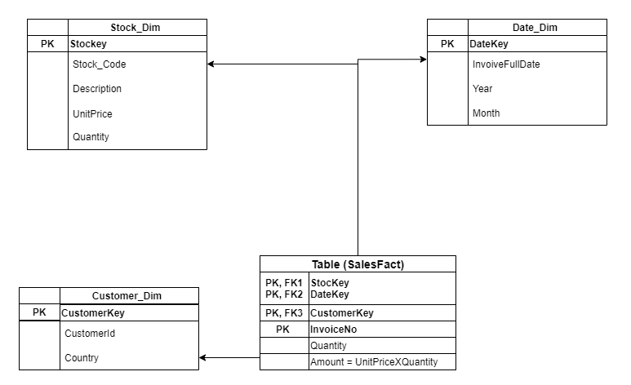
Data Warehouse Design

Slide 6
Star Schema and Justification
Schema Type: Star Schema
Fact Table: FactSales (e.g., Revenue, Quantity).
Dimension Tables:
Customer_Dim: Attributes like CustomerID, Country.
Stock_Dim: Product details like StockCode, Description.
Date_Dim: Year, Month, Day attributes.
Justification:
Simplifies analytical queries.
Optimized for slicing and dicing data.

Slide 7
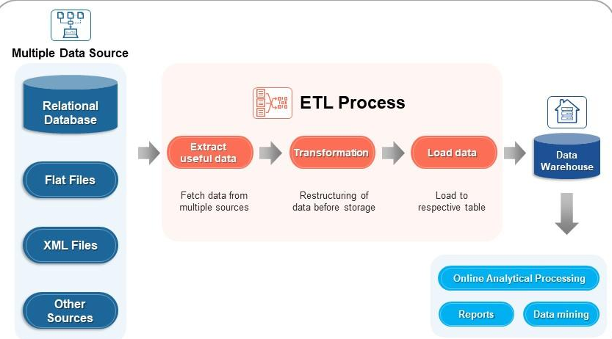
ETL Process

Slide 8
ETL Phases and Outcome
Phases:
Extract: Imported raw data into staging tables.
Transform:
Cleaned data (handled nulls, duplicates).
Calculated measures (e.g., Amount = Quantity × UnitPrice).
Load: Loaded data into the star schema using SQL Server and SSIS.
Outcome: Structured data ready for analytical queries

Slide 9
Reports and Visualizations
Key Reports:
Monthly Sales Trends: Revenue trends over time.
Sales by Country: Geographic revenue distribution.
Top-Selling Products: High-performing products.
High Revenue Days: Sales spikes on significant dates.
Tools:
SSRS: Detailed static reports.
Tableau: Interactive dashboards for trends and insights.

Slide 10
Relational Database Implementation
Schema: Star schema in SQL Server.
FactInternetSales: Stores transactional data.
Dimensions: Customers, Products, Dates.
EXAMPLE QUERY (SQL)
SELECT CustomerKey, SUM(SalesAmount)
FROM FactInternetSales
GROUP BY CustomerKey
ORDER BY SUM(SalesAmount) DESC;

Slide 11
Graph Database Implementation
Schema: Nodes and relationships in Neo4J.
Nodes: Customer, Product, Date.
Relationships: PURCHASED (e.g., SalesAmount, OrderQuantity).
EXAMPLE QUERY (CYPHER)
MATCH (c:Customer)-[r:PURCHASED]->(p:Product)
RETURN c.CustomerID, SUM(r.SalesAmount) AS TotalSales
ORDER BY TotalSales DESC;

Slide 12
Relational Database Implementation
Schema: Star schema in SQL Server.
FactInternetSales: Stores transactional data.
Dimensions: Customers, Products, Dates.
EXAMPLE QUERY (SQL)
SELECT CustomerKey, SUM(SalesAmount)
FROM FactInternetSales
GROUP BY CustomerKey
ORDER BY SUM(SalesAmount) DESC;

Slide 13
Relational Database Implementation
Schema: Star schema in SQL Server.
FactInternetSales: Stores transactional data.
Dimensions: Customers, Products, Dates.
EXAMPLE QUERY (SQL)
SELECT CustomerKey, SUM(SalesAmount)
FROM FactInternetSales
GROUP BY CustomerKey
ORDER BY SUM(SalesAmount) DESC;

Slide 14
Relational vs. Graph Databases - Comparison
Aspect | Relational Database | Graph Database
Performance | Aggregation-heavy queries | Relationship-heavy queries
Ease of Querying | Familiar SQL | Simplified relationship transversal (Cypher)
Use Cases | Financial reporting, trends | Social networks, recommendations

Slide 15
Insights and Key Findings
Data Warehousing:
Star schema simplifies querying and enables efficient trend analysis.
ETL ensures clean, consistent, and ready-to-use data.
Database Comparison:
SQL Server excels at structured queries and aggregations.
Neo4J performs better for relationship-based queries.
Recommendation:
Use relational databases for structured analytics and graph databases for relationship-heavy scenarios.

Slide 16
Conclusion
Achievements:
Developed a comprehensive data warehouse for the retail dataset.
Generated actionable insights through reports and visualizations.
Demonstrated the strengths and weaknesses of relational and graph databases.
Future Work:
Integrate real-time data streams.
Explore hybrid database models for complex applications.

Slide 17
References
UCI Machine Learning Repository - Online Retail Dataset
Link: https://archive.ics.uci.edu/ml/datasets/Online+Retail
Microsoft SQL Server Documentation
Link: https://learn.microsoft.com/en-us/sql/sql-server
SSIS (SQL Server Integration Services) Documentation
Link: https://learn.microsoft.com/en-us/sql/integration-services
Tableau - Building Dashboards and Storyboards
Link: https://help.tableau.com/current/pro/desktop/en-us/dashboards_storypoints.htm
Neo4J Cypher Query Language Documentation
Link: https://neo4j.com/docs/cypher-manual/
AdventureWorks Sample Database
Link: https://github.com/Microsoft/sql-server-samples/releases/tag/adventureworks

Slide 18
Thanking you !

